Slide 1

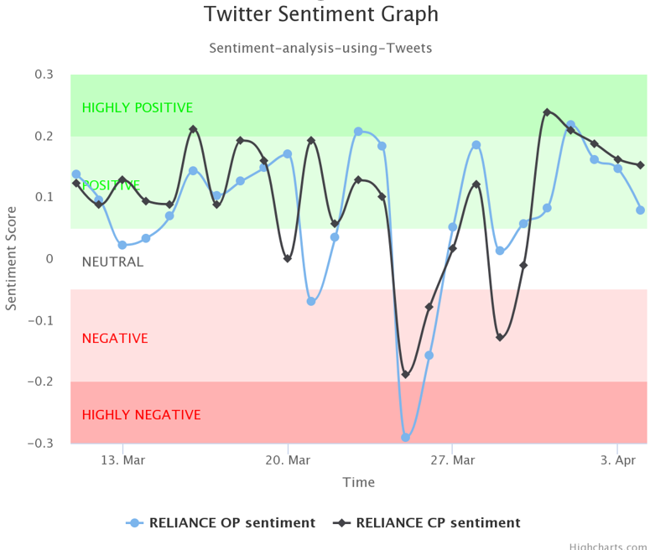

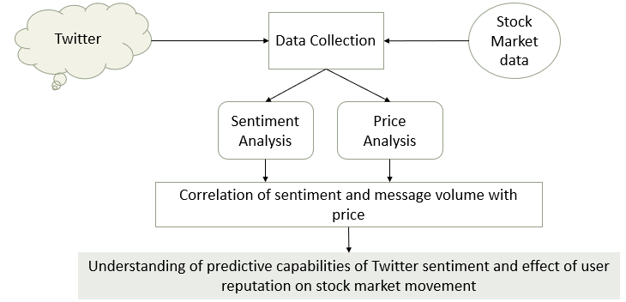

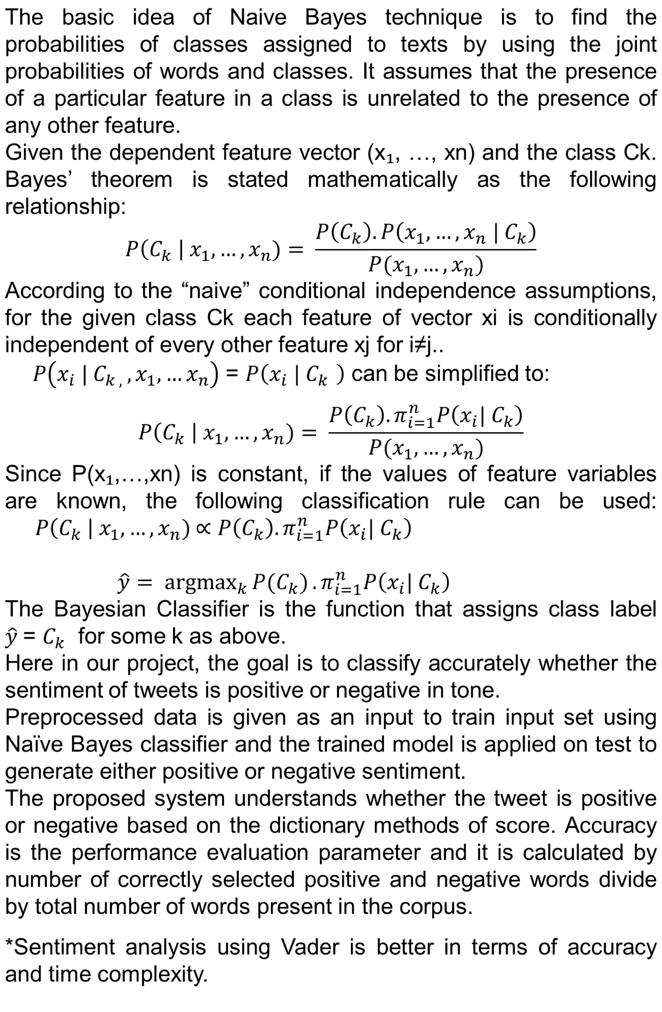

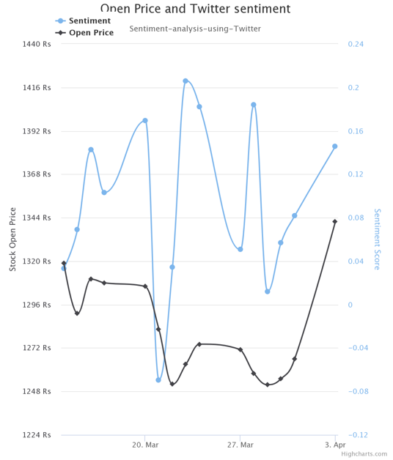
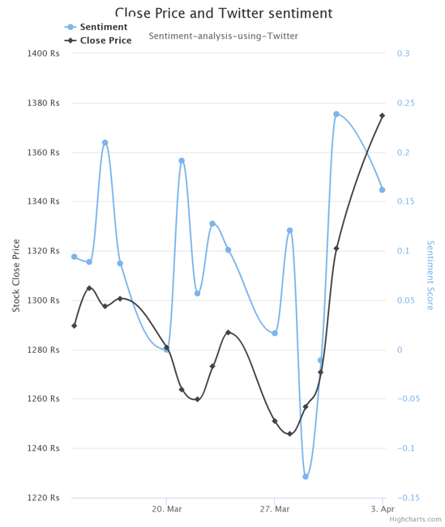
Bayesian Data Analysis
Stock Price Prediction using Naïve Bayes Model
Apoorva Kshirsagar, Shivika Malik, Divyarth Singh
Introduction
System Design & Implementation
Vader Sentiment
Stock Price Analysis
Twitter being the most famous out of all social media sites provides micro-blogging service. Millions of users sign in daily to tweet about any event they want to express their feelings about and Twitter provides that platform to them. Each tweet contains maximum of 140 characters, each tweet may not be useful but still we can examine the sentiment from those tweets about how the mood of public pertaining to that topic is.
In the field of computer science, it has become popular to collect data from social media website and process that data and later analyze it using different techniques to extract relevant data.
In the stated project, data from stock market is needed to make prediction about the stock prices. There are different factors involved in prediction of stock prices as well as tweets sentiment and in this project, we used different techniques to classify data and examine it, collecting tweets is by far foremost important and then later finding correlation between tweets sentiment and stock prices.
Vader sentiment analyzer is known as Valence aware dictionary and sentiment reasoner. It is and powerful tool in python. It belongs to the type of sentiment analysis that is based on lexicons of sentiment-related words. In this approach, every word in the lexicon is rated as positive negative. Vader analyze a text and then check for words which are in lexicon and they have a rating which is given automatically. Vader produces four sentiment metrics from these words ratings which are positive, negative, neutral and compound.
We simply took data from National stock exchange and proceed further with it, as NSE data is robust and we can trust it without any issues as that data is used by many users and companies.
Naïve Bayes Classifier
Correlation
Correlation is calculated which is known as correlation coefficient, whose value falls between -1 to 1. 1 mean a perfect positive correlation which means that if one asset moves up or down, other asset will move in lockstep with it, in the same direction. -1 means a perfect negative correlation which means that if one asset move up or down, other asset will move in opposite direction from it, and there is a zero correlation sometimes which means there is no relation between two.
Use of Linear Regression to find accuracy.
Tweets Collection & Pre-Processing
For tweets collection, we used REST API as it allows to find tweets related to a query of recent tweets. The request of JSON object contains the tweets and their metadata, which includes many information that is time of tweets, location where tweets was written, retweets etc., our main focus was on tweets text and time when it was made. The text of tweets contains too much extraneous words which are not needed in part of sentiment they are mainly URLS, tags, to obtain correct sentiment we have to filter the tweets and remove noisy words. This can be achieved by pre-processing the tweets using python library NLTK.
Problem Statement
Utilize social media to access market sentiment and predict the behavior of stock of certain company
Classify polarity of given text at document, sentence or feature level and determine whether opinion in text is positive, negative or neutral
Using Cross Validation and Linear Regression to predict sentiment and find correlation between sentiment and stock prices
Value for correlation is positive which means that people emotions and actual value are moving in same direction.
Following are the graphs for correlation between prices.
Sentiment Analysis
Sentiment analysis was first major part of our system as this will allow us to compare stock price, we approached this by following 3 techniques out of which one with the best result will be used for further operations.
Proposed Solution
Data collection
1.Using Twitter API to collect tweets(tweet text, date, time)
2.Using National Stock Exchange Data to collect data
Tweet Sentiment Analysis
1.Vader Sentiment (Valence Aware Dictionary and Sentiment Reasoner)
2.Using SVM model
3.Using Naïve Bayes Classifier
Predict Stock market movement using tweet sentiment analysis
1.Linear Regression
Support Vector Machine (SVM)
Support Vector Machine (SVM) is a supervised machine learning algorithm, which can be used for both regression and classification, however it is used mainly in classification problems. In the SVM model we plot data points on a n-dimensional space where n represents the number of features you have and then we perform classification by finding the hyper-plane that differentiate the two classes.
Recommendation
Association rule mining is used for generating Recommendation system(helps in discovering relationship between variables in dataset)

